Slide 1


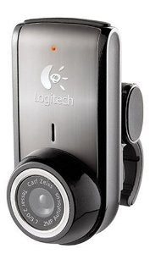
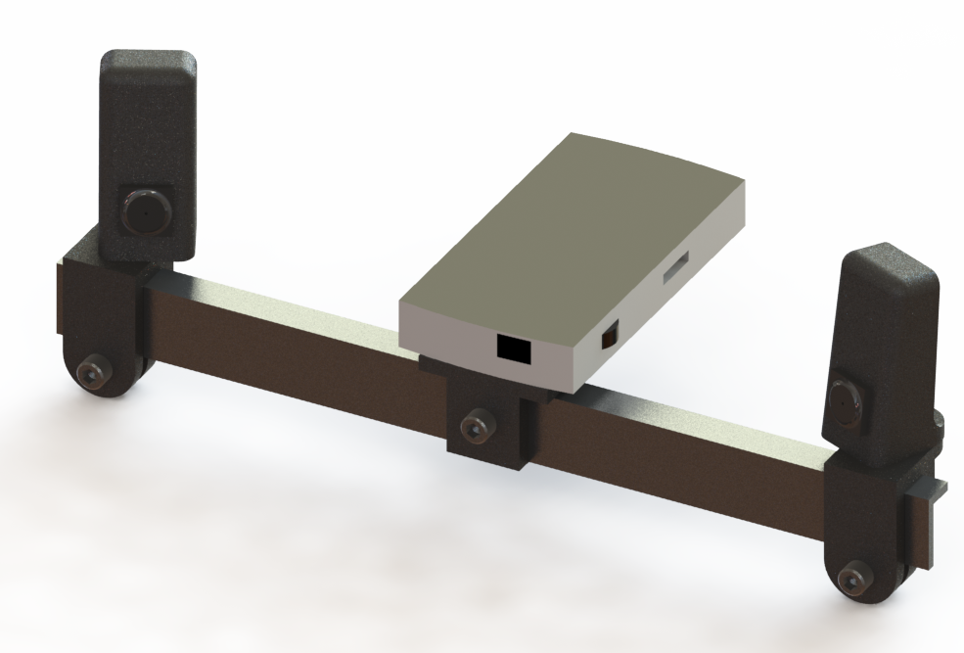
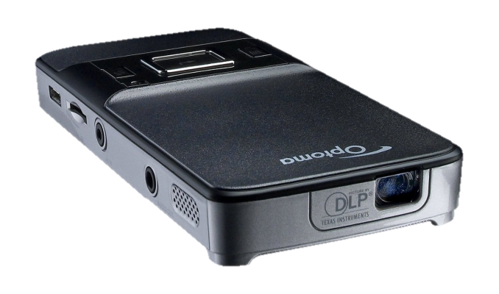


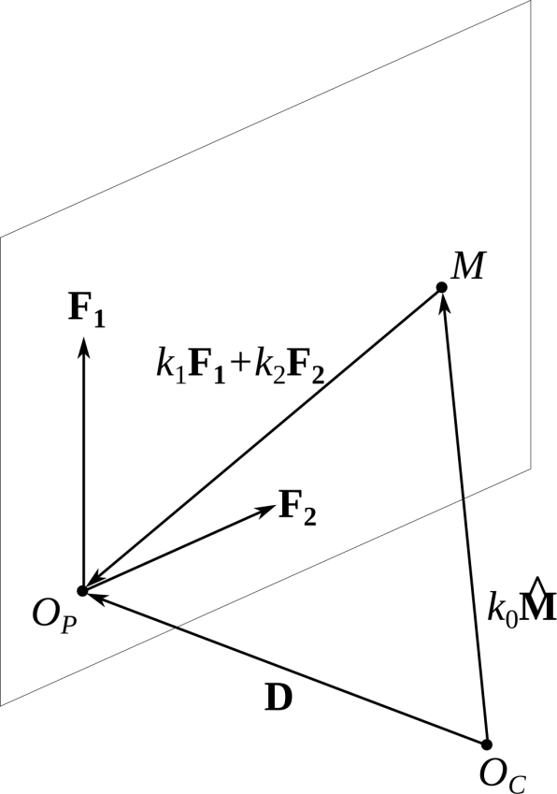
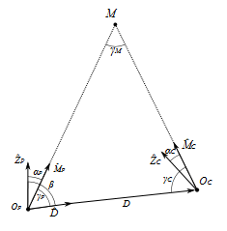
Fully Reversed Engineering: Streamlining three-dimensional component digitization, modification, and reproduction
Ryan Muller and Chris Thomas
Advisor: Cosme Furlong Mechanical Engineering Department
CHSLT – ME
Center for Holographic Studies and Laser μmechaTronics
Abstract
4. Testing the concept through simulation
7. Results
The availability of rapid prototyping enhances a designer’s creativity and speed, enabling quicker development of new products. However, because this process relies heavily on computer-aided design (CAD) models it can often be time costly and inefficient when a component is needed urgently in the field. This paper proposes a method to seamlessly integrate the digitization of existing objects with the rapid prototyping process. Our technique makes use of multiple structured-light techniques in conjunction with photogrammetry to build a more efficient means of product development. This combination of methods allows our developed application to rapidly scan an entire object using inexpensive hardware. Single views obtained by projecting binary and sinusoidal patterns are combined using photogrammetric feature tracking to create a computer model of the subject.
We tested the binary method through simulating using the open-source software POV-Ray.
A 15 cm radius sphere was scanned and radii were fitted to cross sections of the point cloud.
1. Objectives
To design a system for rapid digitization of physical objects for the purpose of reverse engineering
To create a low cost alternative for expensive digitization solutions
To create a streamlined process for digitization that requires minimal user interaction
Axis | Mean Radius(m) | Standard Deviation (um) | Error (um)
x | 0.149992 | 21.12 | -7.92
y | 0.150002 | 16.12 | 1.94
z | 0.149996 | 25.00 | -3.62
Mean | 0.149997 | 20.75 | -3.20
2. Motivation
The ability to quickly digitize a part allows a designer to easily reproduce a component for which CAD files are not available, or allows the designer to create accessories for such components.
For example, Jay Leno uses the NextEngine 3D scanner to quickly reproduce parts for antique cars whose details have been lost to history.
However, current scanners on the market are costly—the NextEngine, for example, costs $2995.
The goal of this project is to build a full field-of-view digitization system at significantly lower cost.
PTI Industries is interested in the utilizing the developed system to obtain 3D shape data for a patented repair process.
5. Hardware
Logitech C905 Webcam
2 MP, 2.8μm cell size, 50 mm min. focal length
Optoma PK201 Projector
854 px horizontal resolution, DLP projection, throw ratio 2.2
3. Structured light reconstruction concept
Cameras: 2 × Logitech C905 Webcam $100
Projector: 1 × Optoma PK201 Pico $250
Parts: Rapid-prototyped from ABS $ 10
Beam: Aluminum L-beam $ 6
Total cost: $366
Project binary patterns onto object
Project sinusoidal fringes onto object
8. Conclusions and future work
Capture patterns
Capture patterns
Calculate difference between images
Calculate phase
6. Scanning process
Convert phase to pixel indices
Setup
Adjustable mounting allows for triangulation geometry to be chosen based on the parameters of the object to be scanned
Camera and projector calibration need to be performed each time the triangulation geometry is changed
Compute pixel indices
Position equipment
Camera calibration
Calculate angle between optical axis of projector and each point on object
Projector calibration
Scanning a single view takes 5-8 seconds
Point clouds are viewable immediately within the developed software
Use camera/projector geometry to recover point cloud
Single view
Combine views
Point cloud views are updated to show the rotation of the object
Holes in data that require additional scans can be seen in the 3D display
(a)
Data acquisition
Reposition object
Create mesh from point cloud
Decoding and triangulation
Calculate new orientation
Point cloud
Align point clouds
9. acknowledgements
The team would like to thank Ellery Harrington, Ivo Dobrev, and everyone else in the CHSLT lab for all assistance they have provided throughout the project.
Mesh
10. References
Notes:
Put the two otoscopes together – may be put a diagram of what’s inside

